Slide 1
Listos California Emergency Preparedness Campaign:
An Innovative Approach to Disaster Preparedness
Presented by the Co-Chairs of Listos CA
September 10th, 2020

Slide 2
Agenda
Introductions
Campaign Background
Campaign Goals
Approach
Research + Community Input
Campaign Success to Date
Lessons Learned
Accessible Engagement: Examples from the Field
Questions

Slide 3
Introductions
Karen Baker
Architect & Co-Chair of Listos California Emergency Preparedness Campaign
Senior Advisor to the Governor- Cal OES
Justin Knighten
Co-Chair of Listos California Emergency Preparedness Campaign
Assistant Deputy Director- Cal OES

Slide 4
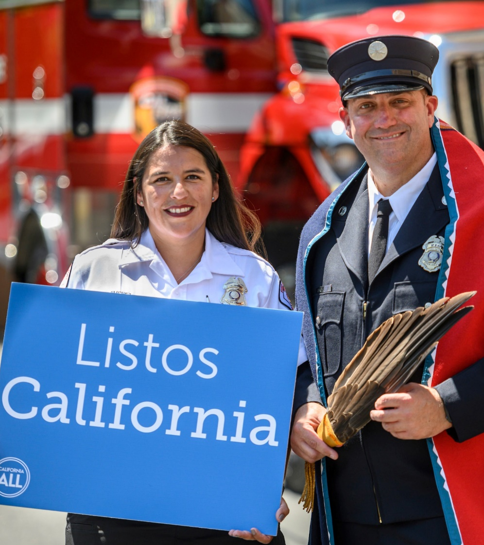
Background
Governor Gavin Newsom and state lawmakers invested $50 million through urgency legislation (AB 72) in January 2019 to establish the California For All Emergency Preparedness Campaign, called Listos California.

Slide 5
Campaign Goals
Engage at least one million diverse and socially vulnerable Californians by December 2020 in disaster preparedness with accessible culturally and linguistically competent support
Work with trusted community allies to provide accessible tips and tools in languages and cultures that represent the great diversity of California
Build a social movement of self-reliance and community spirit that will make both families and communities more resilient

Slide 6
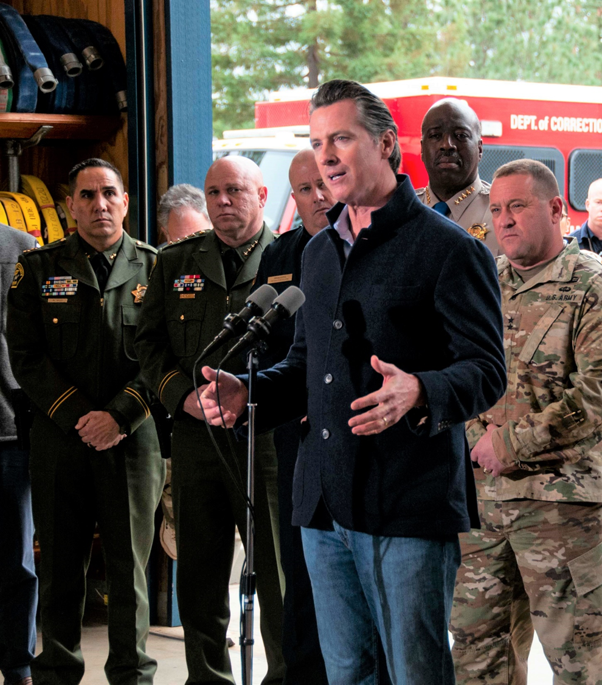
Campaign Goals
“We are leveraging the power of people while ensuring preparedness support and information is not only limited to those who have been privileged enough to access, understand and afford it.”
– Governor Gavin Newsom

Slide 7
Campaign Video

Slide 8
Approach
The guiding principles to our approach include:
Efforts are always people and community centered; this is a bottom up approach to preparedness
Materials and events are accessible in all senses of the word; people with diverse abilities, languages, cultures, and understandings should be able to access our resources
Initiatives are focused on building whole community resiliency

Slide 9
Approach
Programmatic:
Selected 24 CBO grantees in 24 counties
CBOs subgranted to close to 200 local organizations
The CBO’s distribute campaign materials, PPE, and trainings through locally individualized plans (Community Investment Plans)
Close to 70 service and volunteer teams providing trainings to communities throughout the state
Example: Community Investment Plans

Slide 10
Approach
Communications:
Activations to reach all vulnerable Californians with accessible preparedness information
COVID-19 public information dissemination
Relationships with media to tell stories often unheard
Ensuring that the culture of communities are imbedded within each and every unique approach
Example: Social media + working with artists with disabilities

Slide 11
Approach
Material Development:
All new materials based on research, best practices, and community input
Information that is accessible (visual, audio, digital, hard copy, video; reading level appropriate)
Created for audiences of different cultures, languages, and geographies

Slide 12
Approach: 5 Steps Example

Slide 13
Approach Example: Disaster Guide

Slide 14
Research + Community Input
Research and community input are a corner stone of this movement:
Monitor by Deloitte report which included focus groups, 1-1 interviews, and document surveys to find gaps in disaster response and preparedness
EMC research that informed our communications and material development strategy
Input from our on the ground partners like Alameda Public Health Institute
Carefully selected Advisory Team which includes representatives from the State Council on Developmental Disabilities and Disability Voices United
Mapping with University of Sacramento professor

Slide 15
Campaign Success to Date
11,669,806 Californian’s reached overall
930,245 engaged with disaster preparedness resources
10,739,561 reached with COVID-19 communications information
Over 30% of engagements geared towards Californian’s with disabilities

Slide 16
Lessons Learned
Our own learning from the field about engaging individuals with a diversity of abilities
Many of the approaches taken diverged from the status quo of traditional preparedness, this provided some unique challenges

Slide 17
Accessible Engagement: Field Example
The Berkeley Disaster Planning Neighborhood Network matched volunteers with seniors and people with disabilities in Berkeley who needed help during the COVID 19 shelter in place order.
While doing these check-ins they were able to provide disaster preparedness information

Slide 18
Questions

